Slide 1
Unit 1 Quantities & Units
Part A: Electrical Units
Notes:
Hi! Welcome to Unit 1: Quantities and Units, Part A on Electrical Units.

Slide 2
What will you learn?
Commonly used electrical quantities and their units.
Notes:
The objective of this unit is to get familiar with and to explain commonly used electrical quantities and their units.

Slide 3
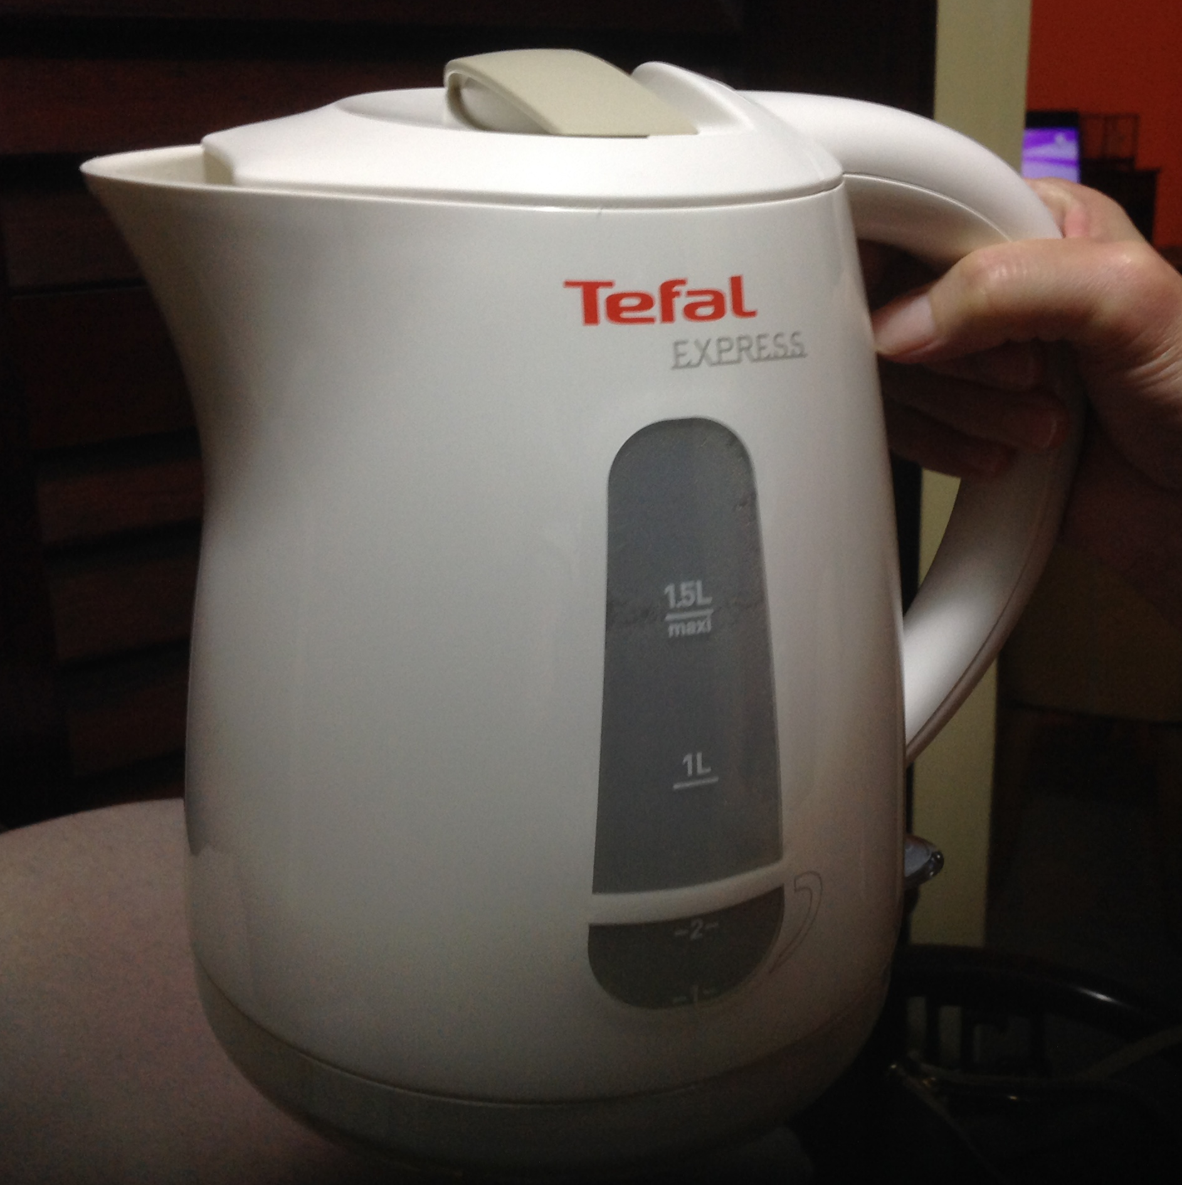
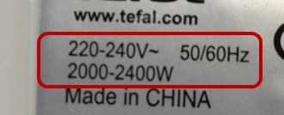

What is in a label?
When you pick up an electric kettle and you notice a label stating:
Voltage: 220–240 V~
Frequency: 50/60 Hz
Power: 2000–2400 W
Alternating Current (AC)
Notes:
There is a label to every electric appliance. When you pick up an electric kettle, you may notice its label stating the numbers: 220 V to 240 V, 50 or 60 Hz, 2000 – 2400 W.
You wonder what information these numbers are telling us.

Slide 4
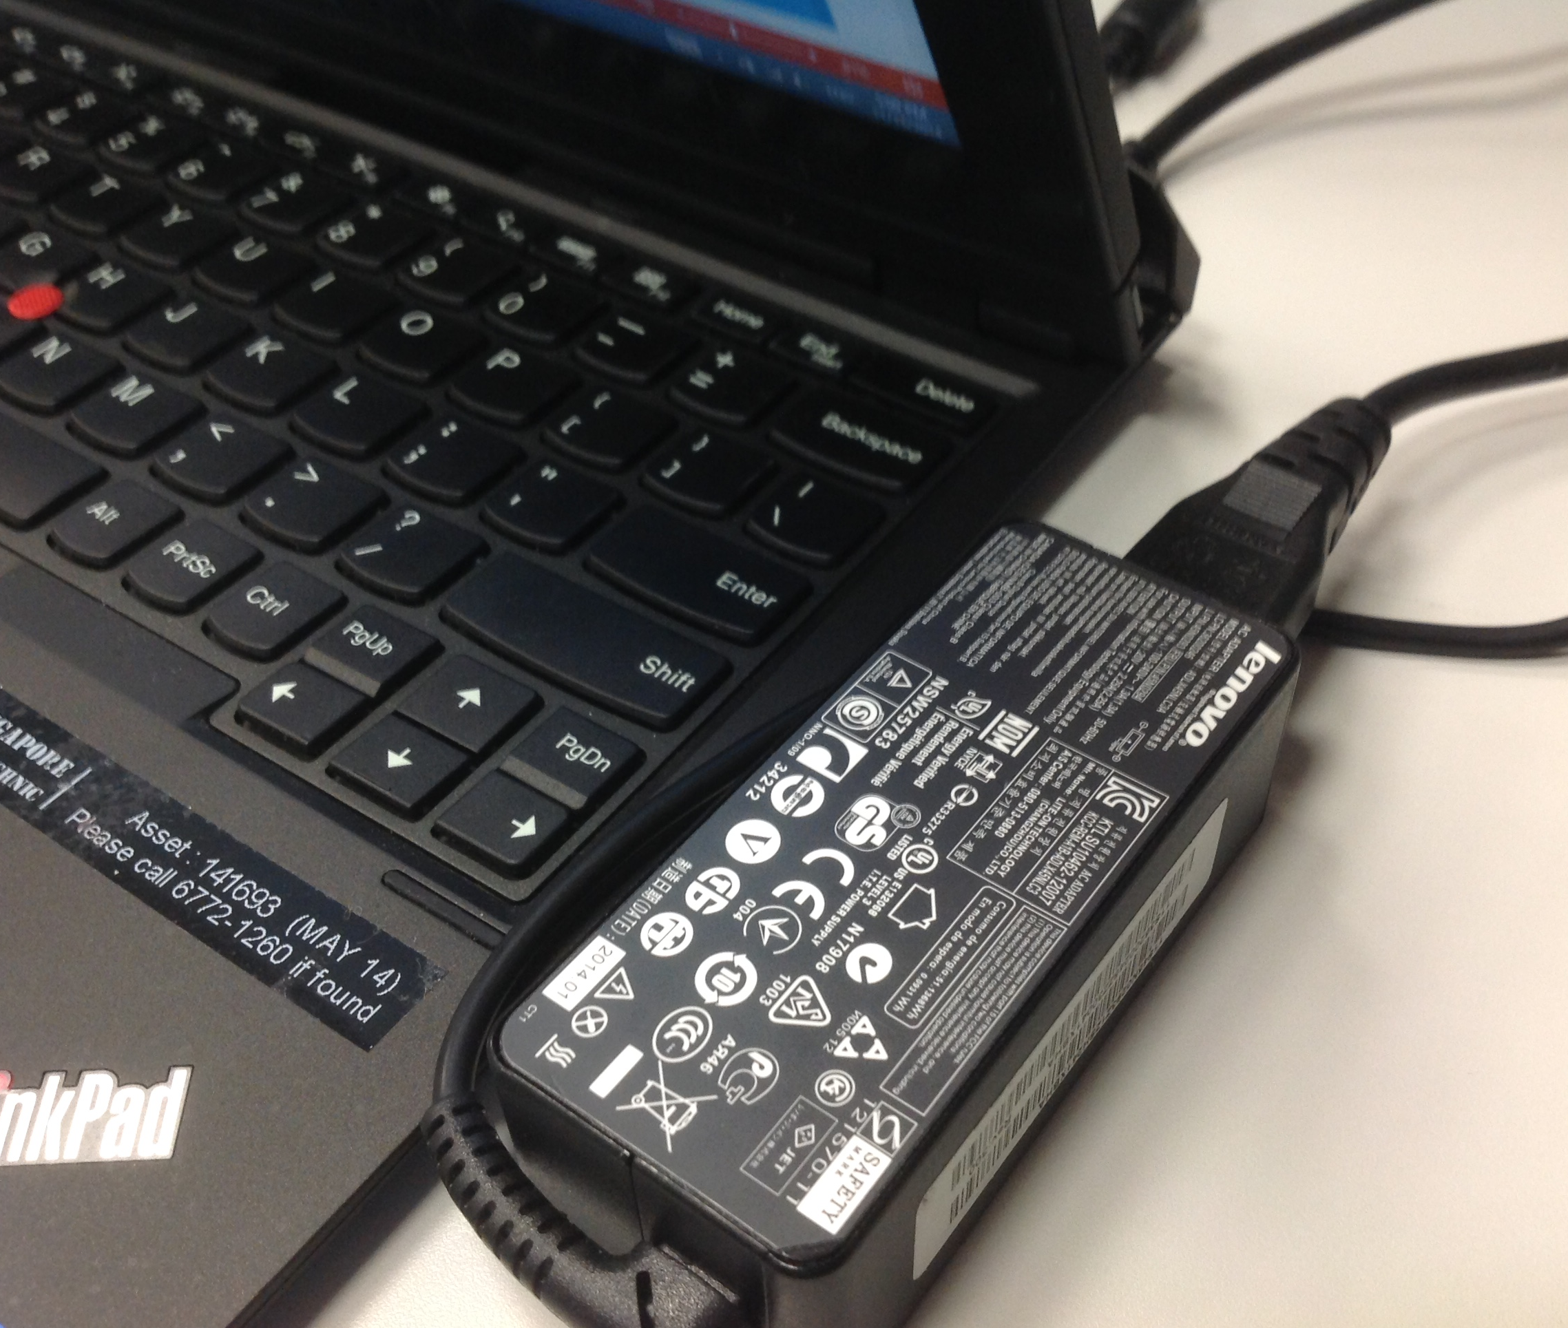
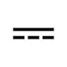
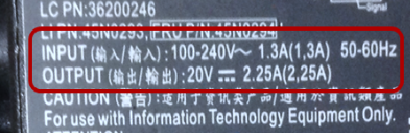
What is in a label?
Your laptop has a power adaptor, its label reads:
Input: 100–240 V~; 1.3 A; 50–60 Hz
Output: 20 V ; 2.25 A
Direct Current (DC)
Notes:
Getting curious, you see the power adaptor connecting to your laptop also has a label displaying these numbers: Input of 100 – 240 V; 1.3 A; 50 or 60 Hz; output of 20 V and 2.25 A. It set you thinking again.

Slide 5
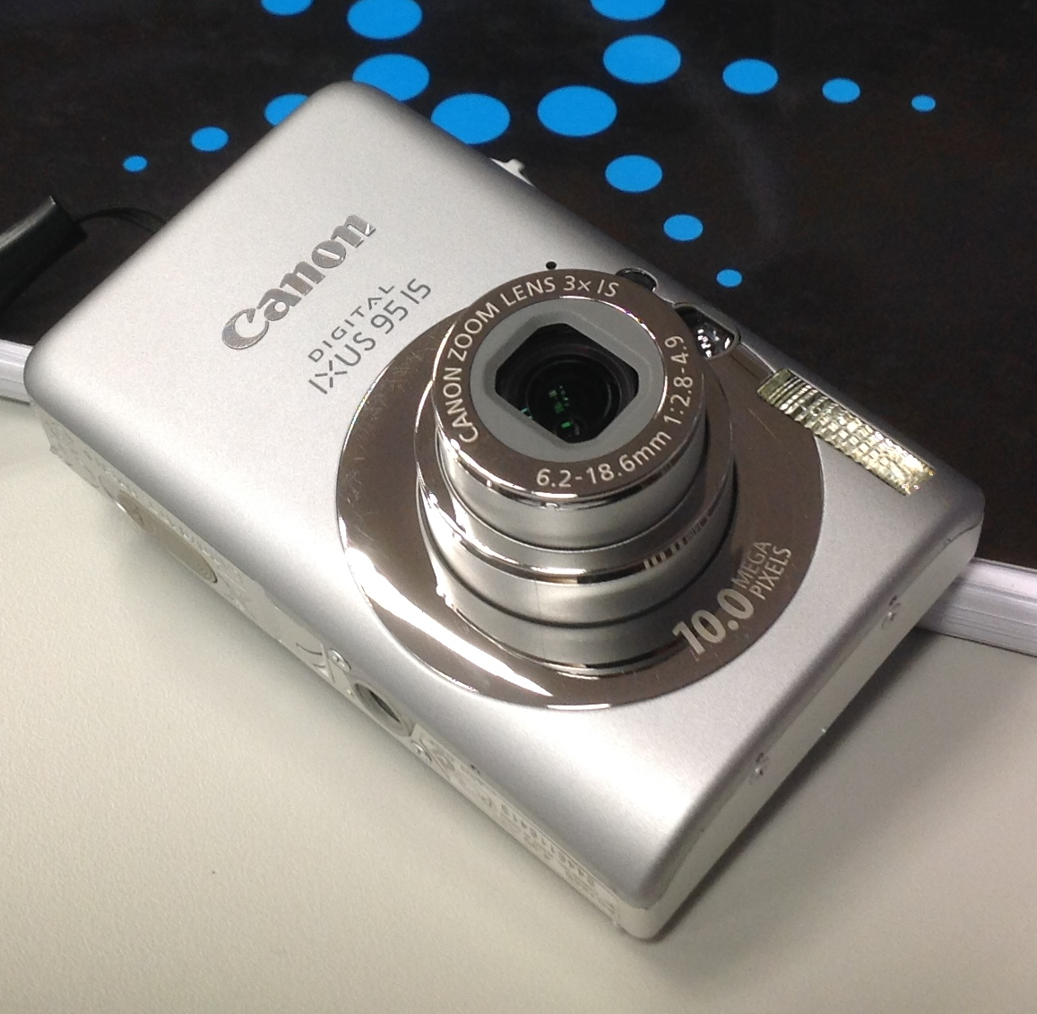
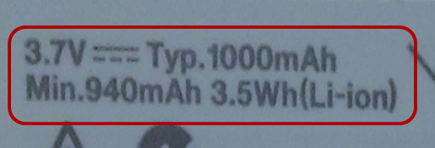
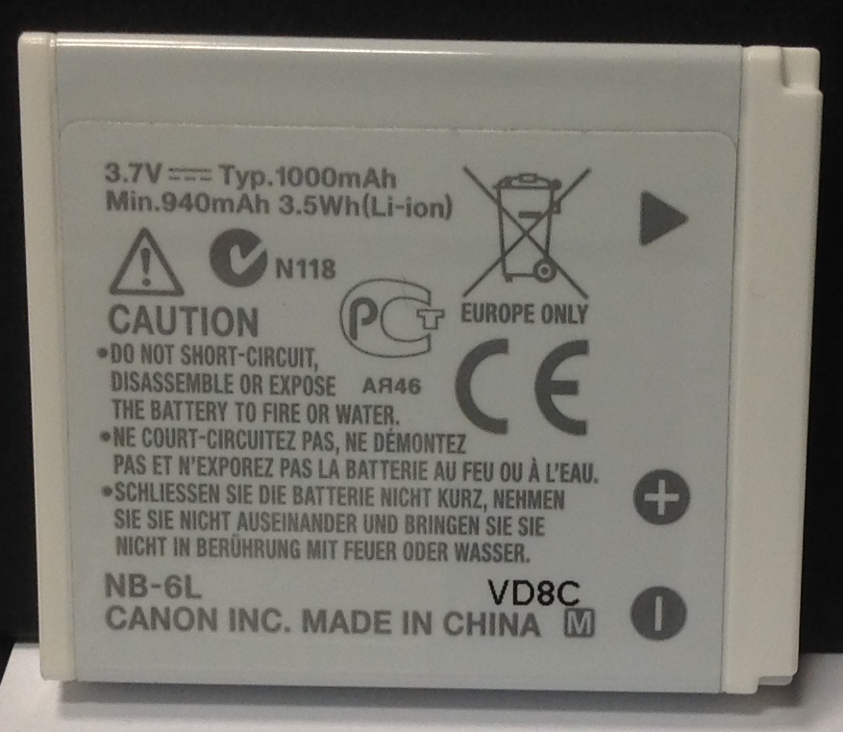
What is in a label?
You retract the battery from your camera and notice that:
Voltage: 3.7 V
Typical battery capacity: 1000 mAh
Minimum battery capacity: 940 mAh or 3.5 Wh
Notes:
You have a camera sitting beside you. Its screen view indicates a low battery. You retract it and notice a label on it reads: 3.7 V, 1000 mAh; Minimum 940 mAh or 3.5 Wh.
Another big question for you.

Slide 6
Common Electrical Quantities, Units and their Symbols
You have just seen some of the electrical quantities listed here:
Quantity | Symbol | Unit | Symbol
Voltage | V | volt | V
Current | I | ampere | A
Power | P | watt | W
Frequency | f | hertz | Hz
Resistance | R | ohm | Ω
Energy | W | joule | J
Time | t | second | s
Notes:
Eager to find out what they all represent? In fact, you have just seen some of the common electrical terms listed here. That is, electrical quantities and units.
Each quantity and unit can be represented by their respective symbols.
Voltage has a symbol V, and its unit volt by V.

Slide 7
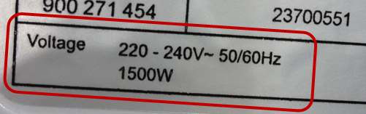
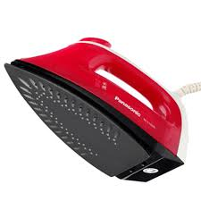

Reading a label in electrical terms
The label of an electric steam iron is used for illustration here:
Required voltage from electricity supply: 220 V – 240 V AC
Operating frequency of the supply: 50 Hz or 60 Hz
Power consumption during operation is: 1500 W

Slide 8
A description in electrical terms
An electrical appliance requires an input voltage of 240 volts operating at a frequency of 50 hertz.
V = 240 V
f = 50 Hz
Voltage
➔ V
volt
➔ V
Frequency
➔ f
hertz
➔ Hz

Slide 9
A description in electrical terms
An electric kettle provides an output power of 2400 watts, when operating at 230 volts and a frequency of 50 hertz.
P = 2400 W
V = 230 V
f = 50 Hz
Power
➔ P
watt
➔ W

Slide 10
A description in electrical terms
An AC adaptor draws an input current of 1 ampere from a power source of 230 volts, and delivers an output voltage of 20 volts and an output current of 2 amperes.
V_{in} = 230 V, I_{in} = 1 A
V_{out} = 20 V, I_{out} = 2 A

Slide 11
You have learned that
electrical quantities and units are found in all electrical appliances,
a label provides useful information of an electrical appliance, and
quantities and units can be represented in their symbols.

Slide 12
Coming Up Next
Scientific Notation

